Slide 1


























Student Name : Charles A
Register No : 312220281
Department : IIIrd B.com Computer Application (Commerce) College : Jeppiaar College of Arts and Science

Slide 2
"Analyzing Employee Attrition through Job Satisfaction Feedback" using Excel
PROJECT TITLE

Slide 3




1.Problem Statement 2.Project Overview 3.End Users
4.Our Solution and Proposition 5.Dataset Description
6.Modelling Approach
7.Results and Discussion 8.Conclusion
3/21/2024 Annual Review

Slide 4
PROBLEM STATEMENT
To Analyse the Attrition i.e., Employee turnover by examining the Job satisfaction level by reviewing the feedback for job .

Slide 5

PROJECT OVERVIEW
Th•i.s project aims to examine employee attrition by analyzing job satisfaction levels through feedback. The goal is to identify patterns in turnover, understand the factors influencing job satisfaction. The findings will assist in developing strategies to improve job satisfaction, reduce turnover rates, and promote a more stable, motivated workforce.

Slide 6



WHO ARE THE END USERS?
MANAGING DIRECTOR
-To Examine the Employee Turnover
Human Resources (HR) Teams
Management & Executives
Team Leaders & Supervisors
Business Analysts

Slide 7

OUR SOLUTION AND ITS VALUE PROPOSITION
Conditonal Formatting - To Highlight the Blanks cells and change the colour of the cell .
Sort & Filter - Remove the Blank Missing Values. Pivot Table - Summary of Employee Turnover from the Company through job satisfaction.
Formulas - IFS (To get the Feedback for Job) Graphs- (Bar Chart & Pie Chart) - FINAL REPORT on Employee Attrition

Slide 8
Dataset Description
Employee Attrition Dataset - Kaggle.com
Variables : 35 Features
Age = <int> Numerical Values
Attrition = <fct> Text Values (Yes/No) Gender = <fct> Text Values (Male/Female) Job Level = <int> Numerical Values
Job Satisfaction = <int> Numerical Values Feedback for Job = <fct> Text Values Performance rating = <int> Numerical Values Total Working Years = <int> Numerical Values Overtime = <fct> Text Values (Yes/No)

Slide 9

THE "WOW" IN OUR SOLUTION
New Formula Used : IFS
To Find out the Feedback for Job by Analysing the Job Satisfaction Level .
3/21/2024 Annual Review

Slide 10
MODELLING
Dataset Collection - Employee Attrition Dataset
Dataset Preparation - Clearing Blanks, Filtering and Removing Blank data in the Dataset.
Using IFS formula to attain the Feedback for Job through Job Satisfaction Level (1,2,3,4) (Satisfied & Dissatisfied)
Insert Pivot Table to Summarize the Dataset on Employee Attrition based on Gender, Job Satisfaction Level, Attrition (Yes/No) and Feedback for Job.
Data Visualization using Bar Chart and Pie Chart to represent the turnover by gender and satisfaction level.
Final Report

Slide 11
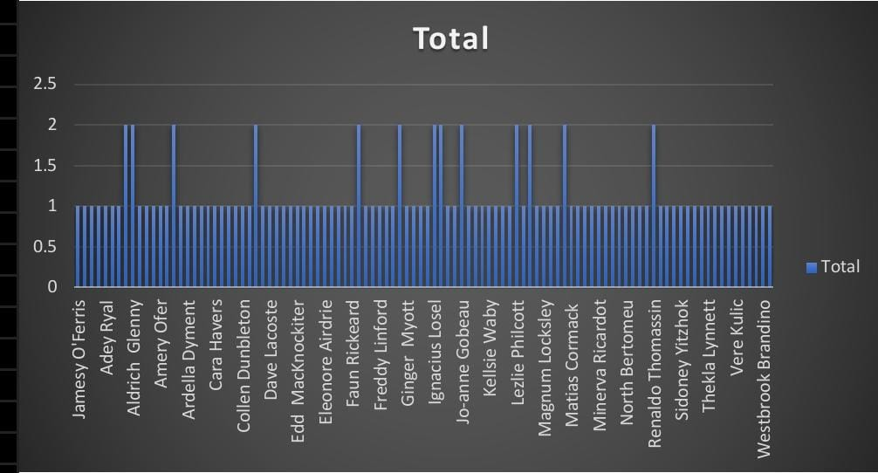
RESULTS
d
d

Slide 12
Conclusion
In conclusion, this project highlights the importance of analyzing employee turnover through job satisfaction feedback to uncover underlying factors that contribute to attrition. By identifying patterns in employee dissatisfaction, organizations can gain valuable insights into the root causes of turnover. Implementing data-driven strategies based on these insights can enhance job satisfaction, improve employee retention, and ultimately reduce turnover rates, fostering a more stable, productive, and engaged workforce that supports long-term success.

